Slide 1

TRADITIONAL
GAMES PROGRAMME
UHE3072
TECHNOLOGY FOR HUMAN CAPITAL
GROUP MEMBERS
WAN NUR HAFEZA HASLINDA BINTI WAN HASSAN (AA13247)
NUR SYUHAIDAH BINTI ISMAIL (CB13006)
NUR AQILAH BINTI MOHD SABANDI (AA13249)
YOGENDRAN A/L VELAEIDOM (CD11107)
KALAIYARASAN A/L RAMASAMY (CD11102)

Slide 2
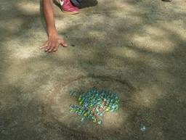
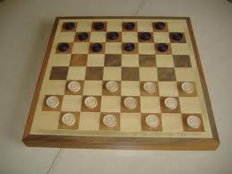
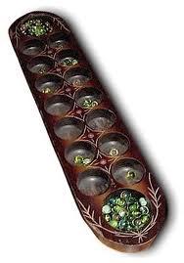
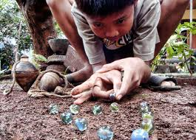
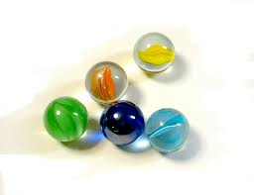
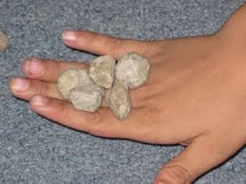
Traditional games programme

Slide 3
Objective of Traditional Games Programme
Expose students of University Malaysia Pahang (UMP) with closer background Traditional Games in Malaysia.
To build and strengthen the relationship between students of University Malaysia Pahang (UMP).
Participate in and learn to play traditional games are a tradition since time immemorial.
Gain experience, understand and appreciate the concept of unity in line with the 1Malaysia concept through such programme

Slide 4
PROJECT TENTATIVE
9:00 – 9.30 am | Student Registration
09:30 – 10:35 am | Talk 1: Introduction and teach how to play traditional games Congkak Batu Seremban
10.35 – 12.40 pm | Module 1 : Start playing traditional games
12:40 – 2.00 pm | Lunch, Prayer and Rest
2:00 – 2.45 pm | Talk 2: Introduction and teach how to play traditional games Dam Haji Guli Tanah
2.45 - 4.30 pm | Module 2 : Start playing traditional games
4.30 –4.45 pm | Souvenir session
4.45 – 4.55 pm | Last speech for the students from team members of project Photograph session
5.00 pm | All Students Dismiss

Slide 5
LEARNING OUTCOMES
Improve leader skill
Decision Making Skills
Good community
Team Work
Handle Program

Slide 6
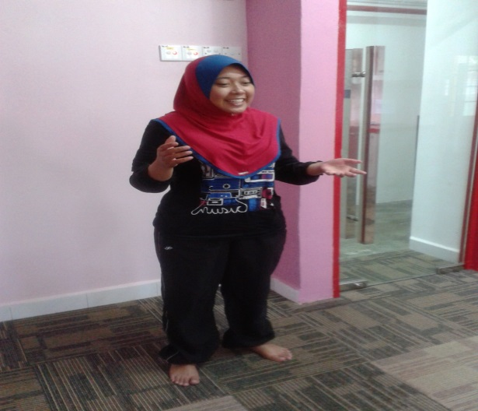
At the morning session
Briefing about the Traditional Games
Talk 1: Introduction and teach how to play traditional games
1. Congkak
2. Batu Seremban

Slide 7
At the evening session
Talk 2: Introduction and teach how to play traditional games
1. Dam Haji
2. Guli Tanah

Slide 8
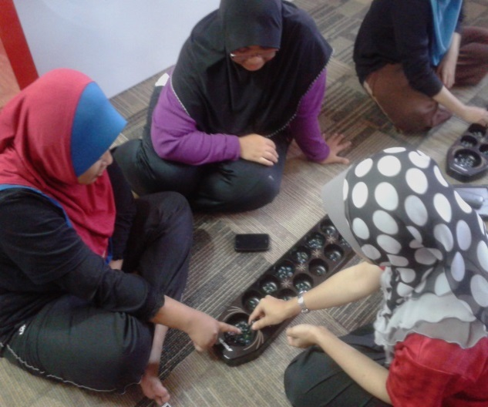
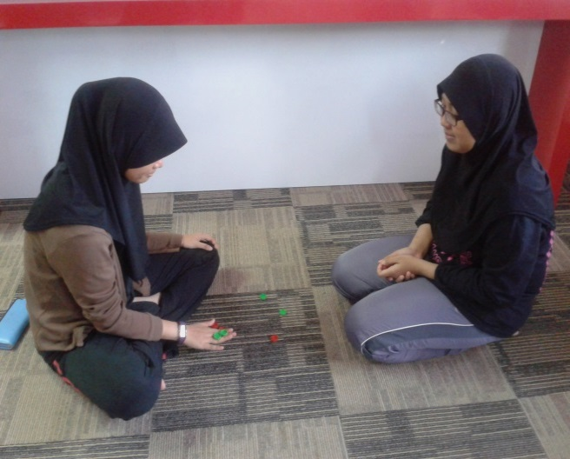
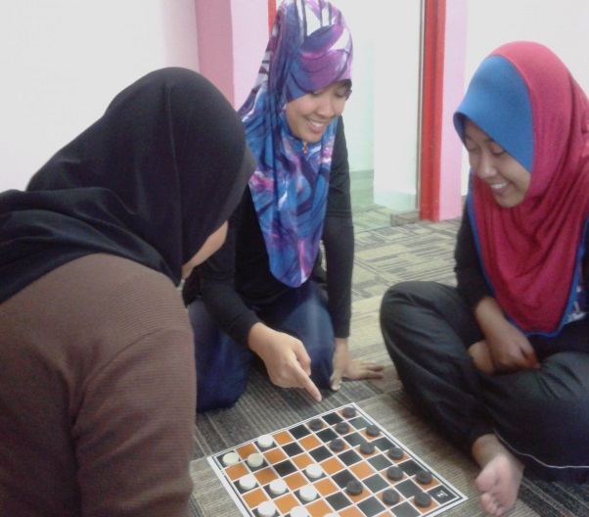
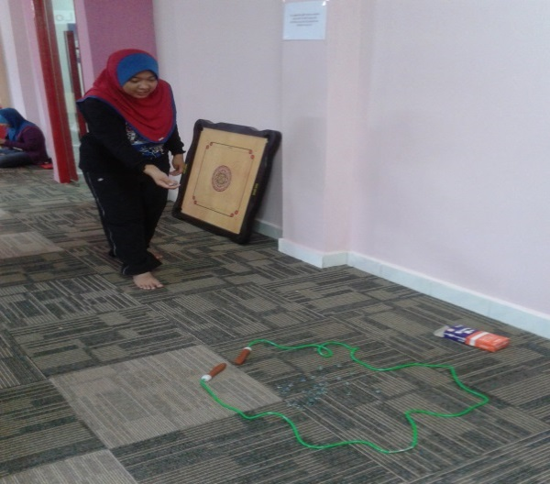
TEACH “ HOW TO PLAY THE TRADIONAL GAMES”

Slide 9
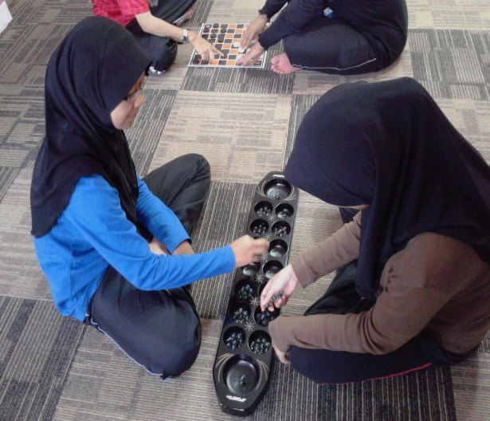
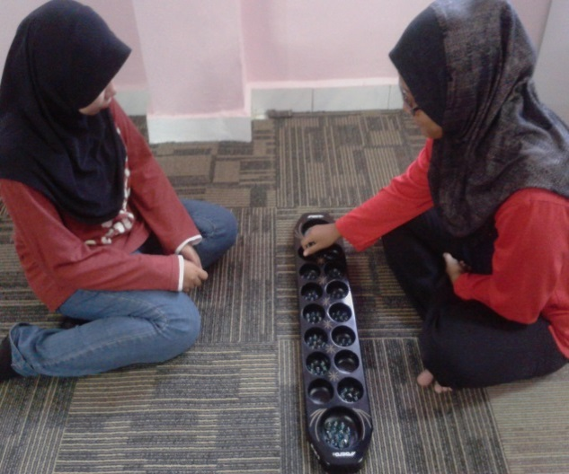
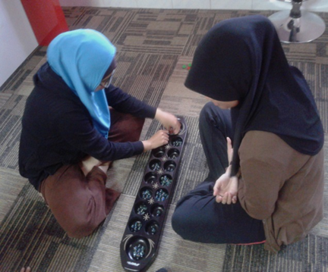
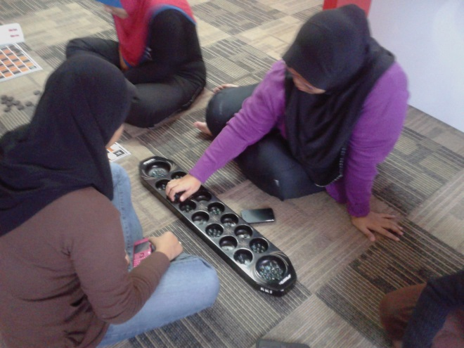
PLAYING TRADITIONAL GAMES

Slide 10
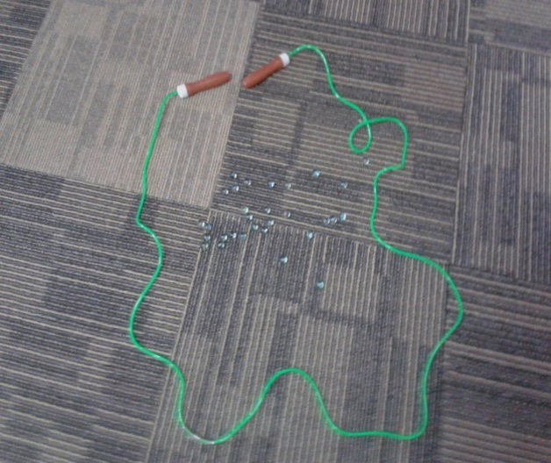
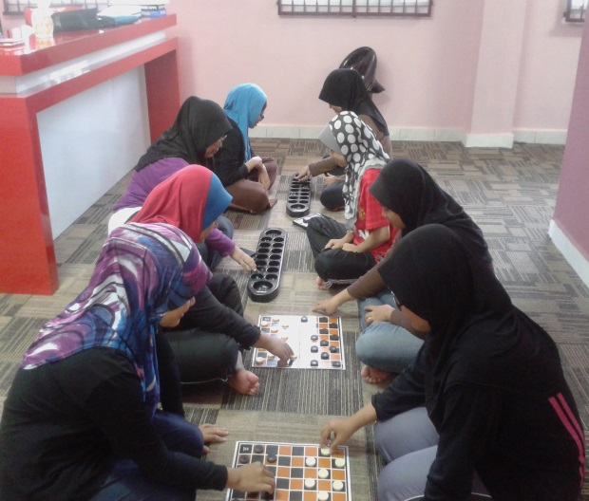
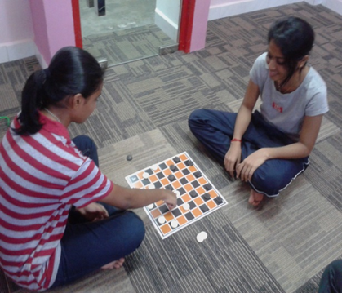
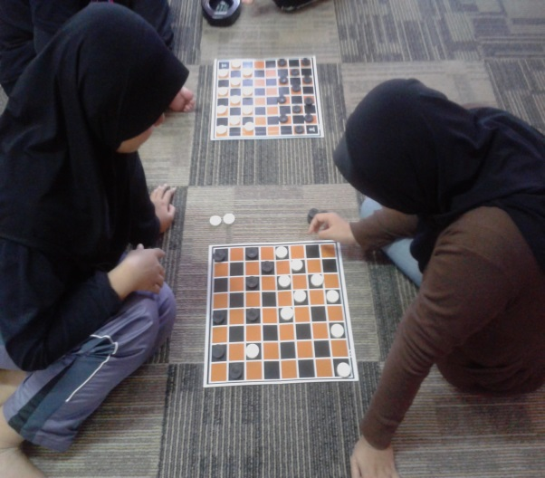
PLAYING TRADITIONAL GAMES

Slide 11
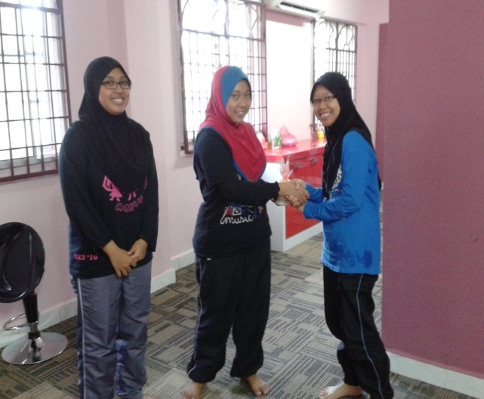
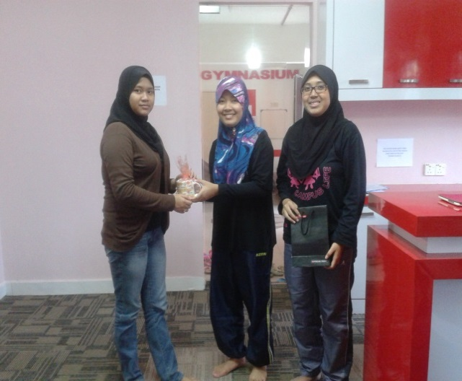
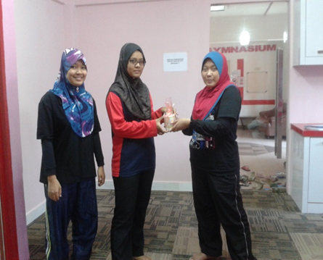
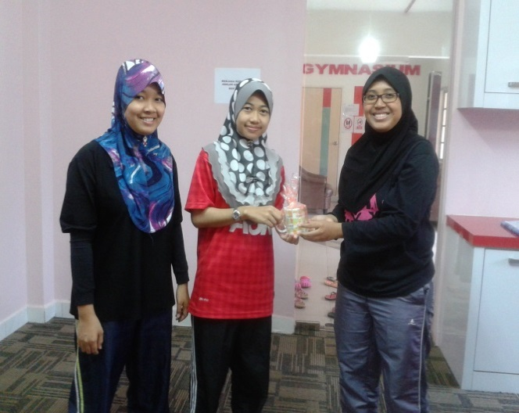
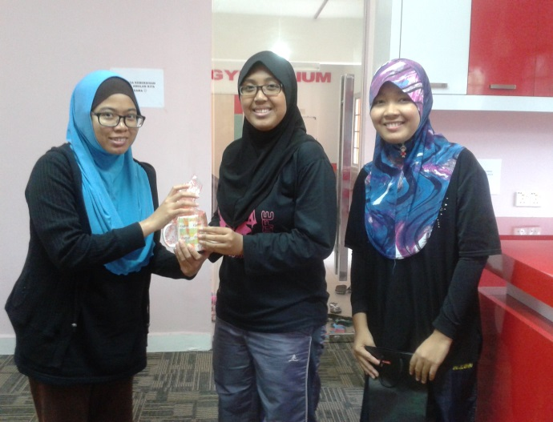
SOUVENIR SESSION

Slide 12
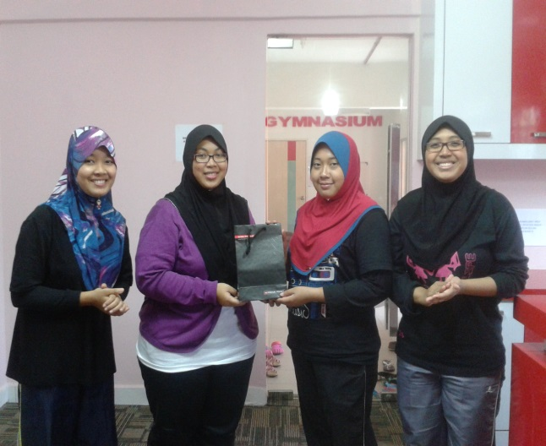
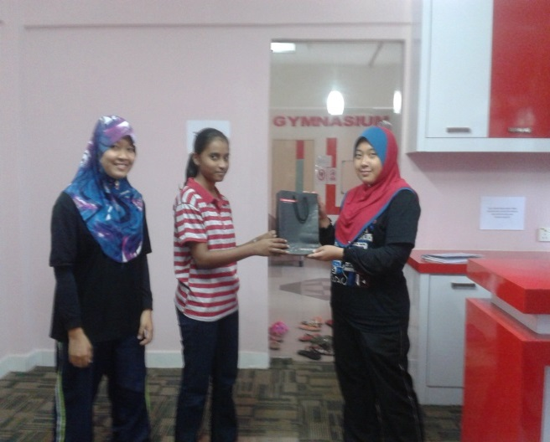
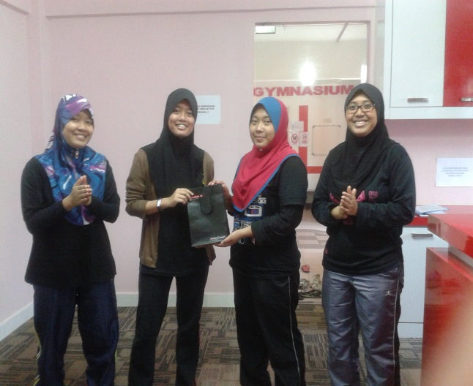
PRIZES FOR THE WINNER

Slide 13
TALK MODULE “HOW TO PLAY TRADITIONL GAMES”

Slide 14
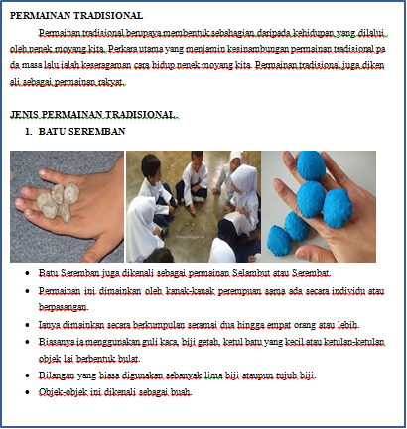

Slide 15
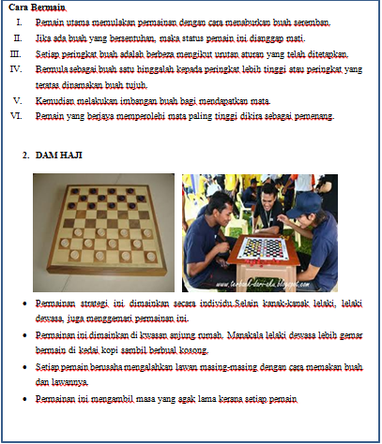

Slide 16
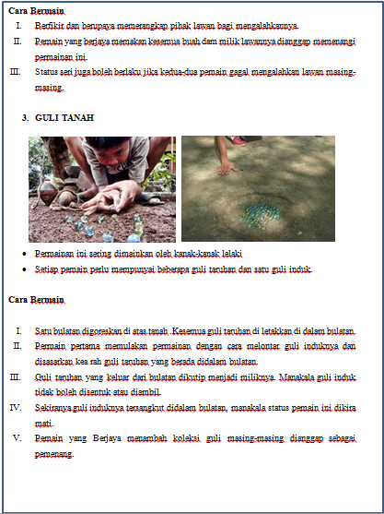

Slide 17
